Slide 1


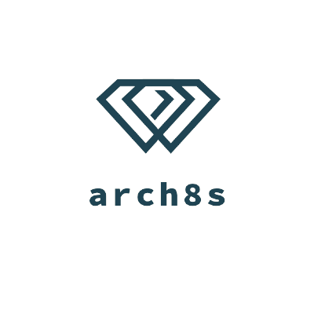

Spotlight
Illuminate Possibilities
coordinated by
Notes:
Hello everyone, we are Arch8s. Today we’re happy to present our Spotlight solution for this season O’Reilly Architectural Katas!

Slide 2


Nova is a candidate in need of professional help transitioning their technical career
Wants to find someone who has a deep knowledge with regard to switching their career from a support center role to a Junior SRE*.
Max is CIO* at a private company and helps as a career mentor at The FoxOverDogs Foundation NPO*
His skills are beneficial to anyone needing help transitioning to a technical career without any previous experience.
* SRE - Site Reliability Engineer
* CIO - Chief Information Officer
* NPO - Non-profit organisation
Notes:
I: Hi, Nova here. I've been working in a support center since 2017 and I don’t enjoy it. I want to change my job and gain a career. I'm looking for help becoming a junior SRE and all my Google searches gave me no real answer. I am lost.
A: Hi, I'm Max. I do volunteering for FoxOverDogs Foundation. With over 20 years experience in IT management and directorship, I’ve been lucky enough to use my knowledge to help others transition into new technical careers.

Slide 3
Using Spotlight…
… to become a Junior SRE*, Nova will
… Max will be able to
publish a list of NPO services
have regular meetings with candidates
find a trusted partner to reach overarching goals
improve funding with donations
understand the performance and improve services further
find a certified career advisor
receive an actionable checklist
attend weekly SpotLives
understand where they are
donate to the NPO*
finally transition their career
* NPO - Non-profit organization
* SRE - Site Reliability Engineering
Notes:
I: Spotlight comes as a relief to the pains Nova experienced alone as well as helping Max to reach more candidates.
Spotlight provides automated mentor matching. We match as many traits between candidates and mentors to find the best match.
For candidates:
Certified mentors
Career roadmaps
Visual progress
For non-profits and mentors:
Networking
Audience growth
Partnerships
Analytics and reporting

Slide 4


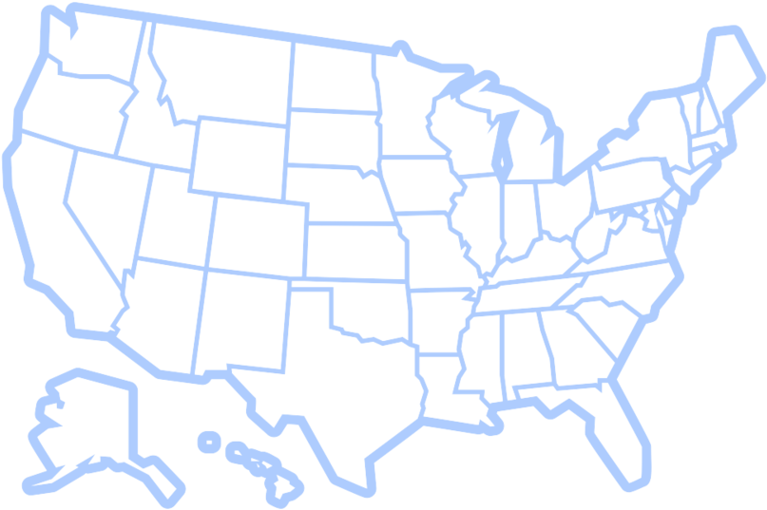




10.7mio
1.5mio
People looked for a job
Registered NPOs in US
180 mio
10%
People searched online courses
US work-force in the NPO industry
25%
56%
Volunteered at least once
Made a donation to NPO
Notes:
A: According to the National Center for Charitable Statistics (NCCS)
Almost eleven million people looked for a job in 2020 in the United States.
One hundred and eighty million were interested in online courses.
Yet on the other hand, there were one and a half million registered non-profit organizations, and a quarter of the citizens volunteered at least once for any of them.

Slide 5










Business Context
Networking
Challenges
Forums
Weekly Spotlives
Mentor Matching
Partnership
Visibility
Coaching
Collaboration
Career Roadmap
Notes:
I: Our Spotlight platform brings effective collaboration between non-profits and candidates.
For candidates looking for career advice:
Coaching,
Weekly Spotlives,
Challenges,
Mentor Matching and
Career Roadmap
For non-profits:
Networking,
Forums,
Collaboration,
New partnerships and
Improved visibility

Slide 6



Spotlight Actors
NPO
Admin
Candidate
Mentor
Community
Leader
Visitor
Notes:
We identified the following roles within our Spotlight app:
A visitor is an unauthorized actor who can browse communities, events, etc
A candidate is a registered user, who decide to change their career
NPO admin acts on behalf of an NPO in the platform and defines their list of offered services
Mentor - is a volunteer who supports candidates with mentorship and career advice
Community Leader - onboards NPOs, and facilitates regular meetings with NPOs

Slide 7
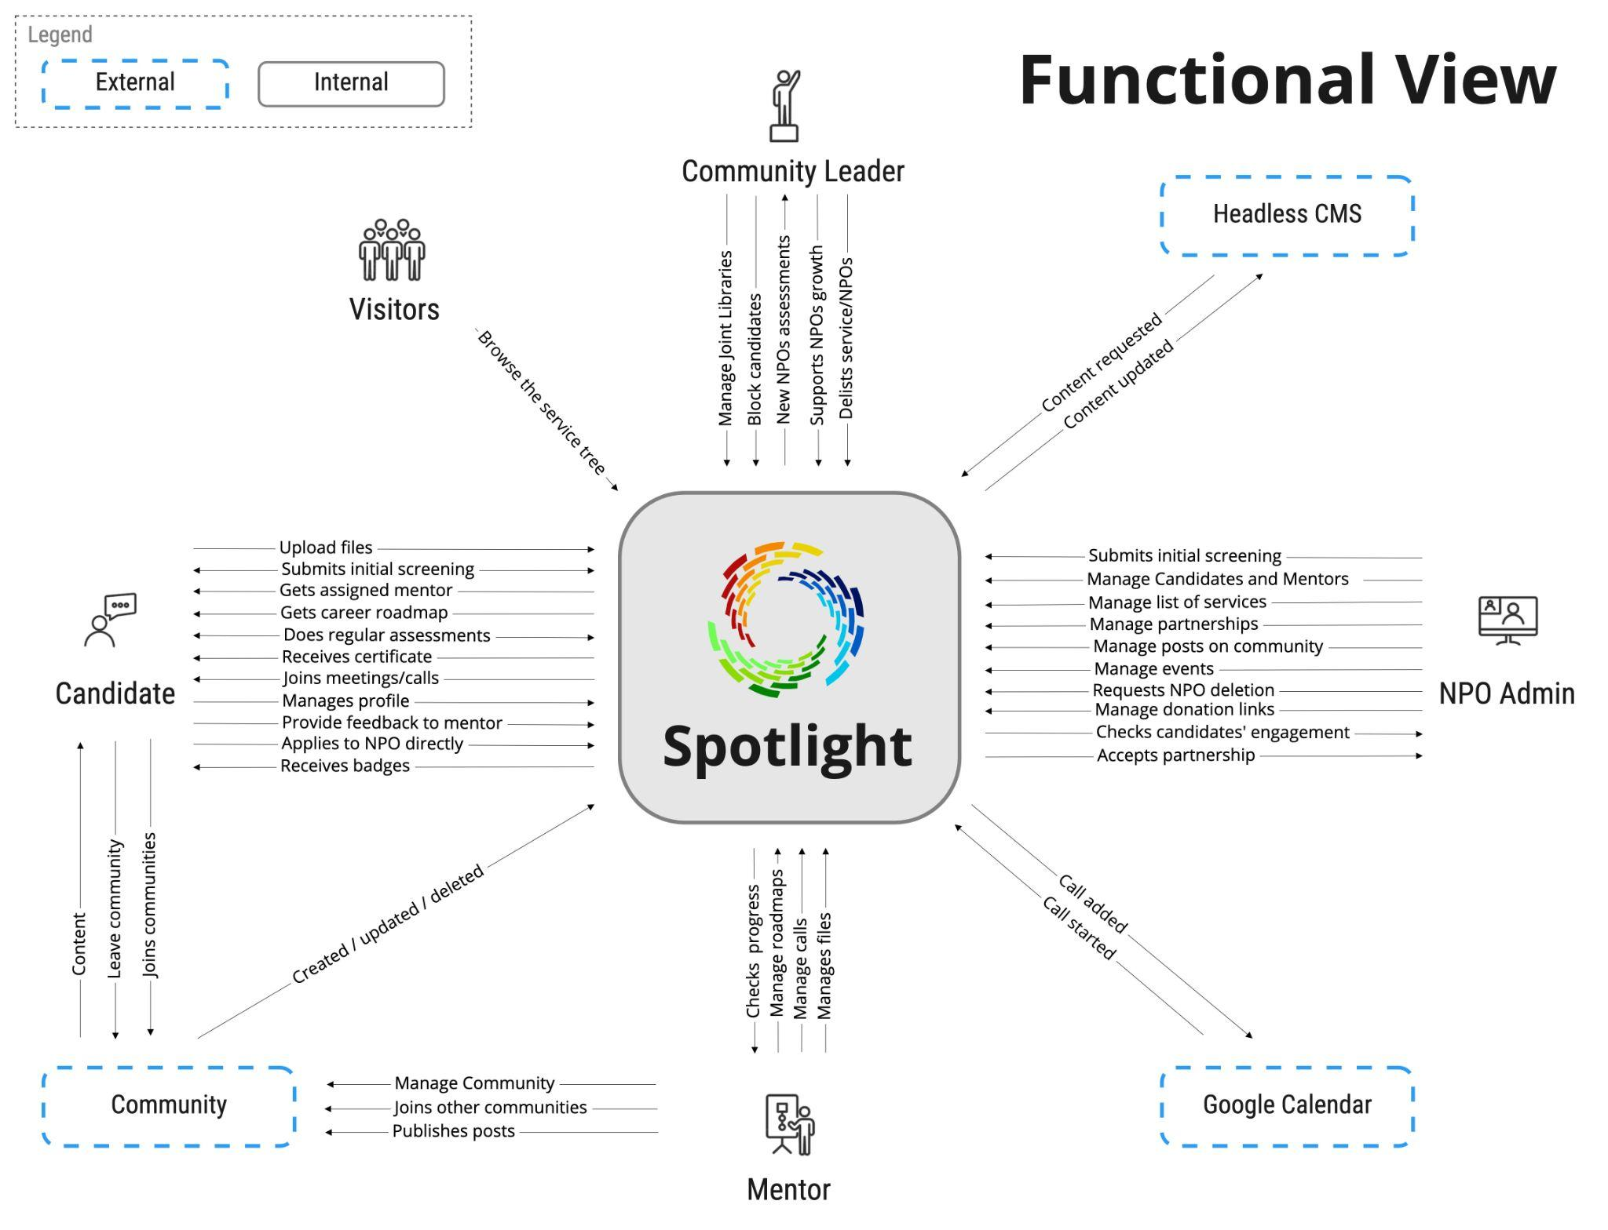
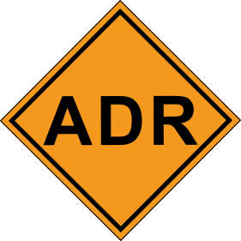
ADR-013
ADR-017
* ADR - Architecture Decision Record
Notes:
This represents the system functionality and requirements we identified to enable Spotlight to work effectively.
Every action is recorded as a user story in our repository.

Slide 8

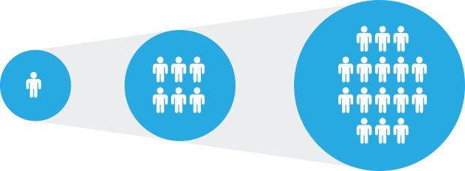

Key Characteristics
Cost
Scalability
Simplicity
*MOOC - Massive Open Online Courses
Notes:
I: Based on Business requirement analysis we identified three key characteristics for our architecture.
Cost - Diversity Cyber Council has a limited budget,
Scalability - since we focus on open online courses, our research has shown 180 million potential visitors
Simplicity - we are working on diversity, so we can reach a larger audience

Slide 9
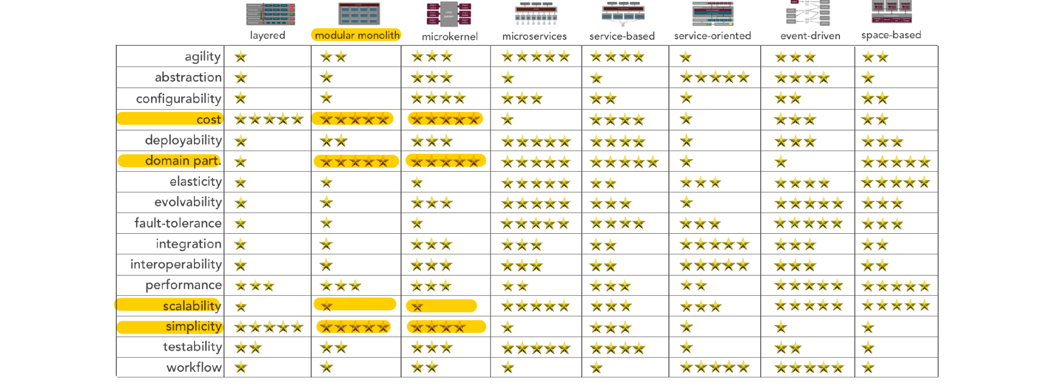
* Created by Mark Richards, DeveloperToArchitect.com
Notes:
Using Architectural Styles Worksheet by Mark Richard from DeveloperToArchitect.com, we highlighted the identified key characteristics. And as you can see the two most suitable options are modular monolith or microkernel.

Slide 10
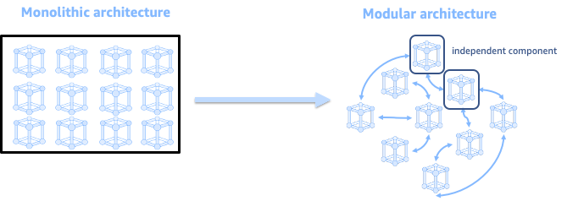
Monolith, but modular
ADR-007
Notes:
We decided to use a modular monolith architecture style.
Because of the startup nature of our project, the scope could change dramatically during the Proof Of Concept phase.
We want to be able to scale some parts of the system to effectively use resources,
so we need to keep modules isolated from each other.
You can get more information this decision from ADR-007.

Slide 11
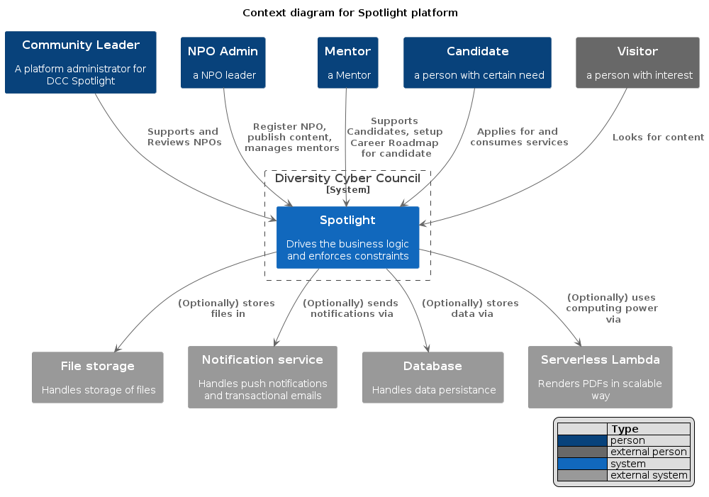
Notes:
C4 stands for Context, Container, Component and Code.
The System Context diagram shows how the Spotlight fits into Diversity Cyber Council.
On top, you see all actors and their responsibilities.
In the middle we have our Spotlight system.
At the bottom we have all the external services our Spotlight system uses.

Slide 12
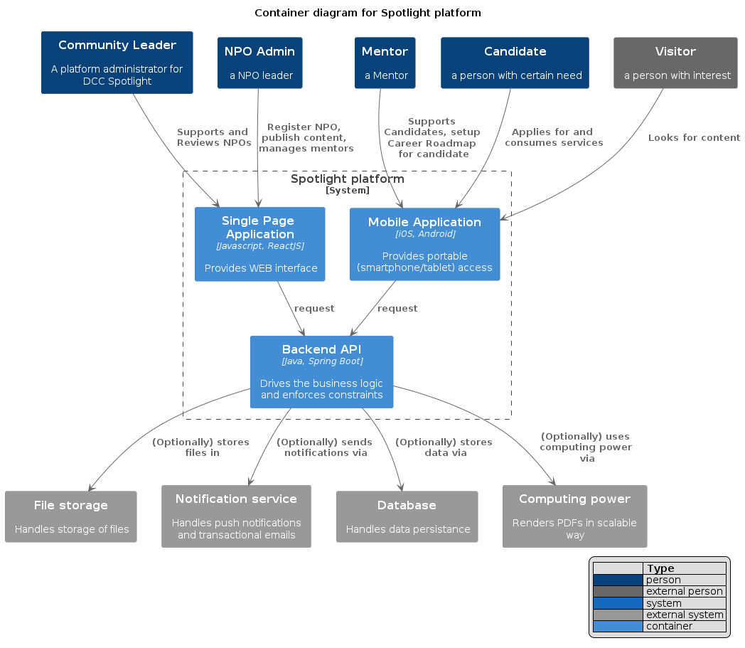
ADR-002
ADR-007
Notes:
Here we see a Container diagram which provides deeper view into the scope of our Spotlight system, showing our high-level technical building blocks.

Slide 13
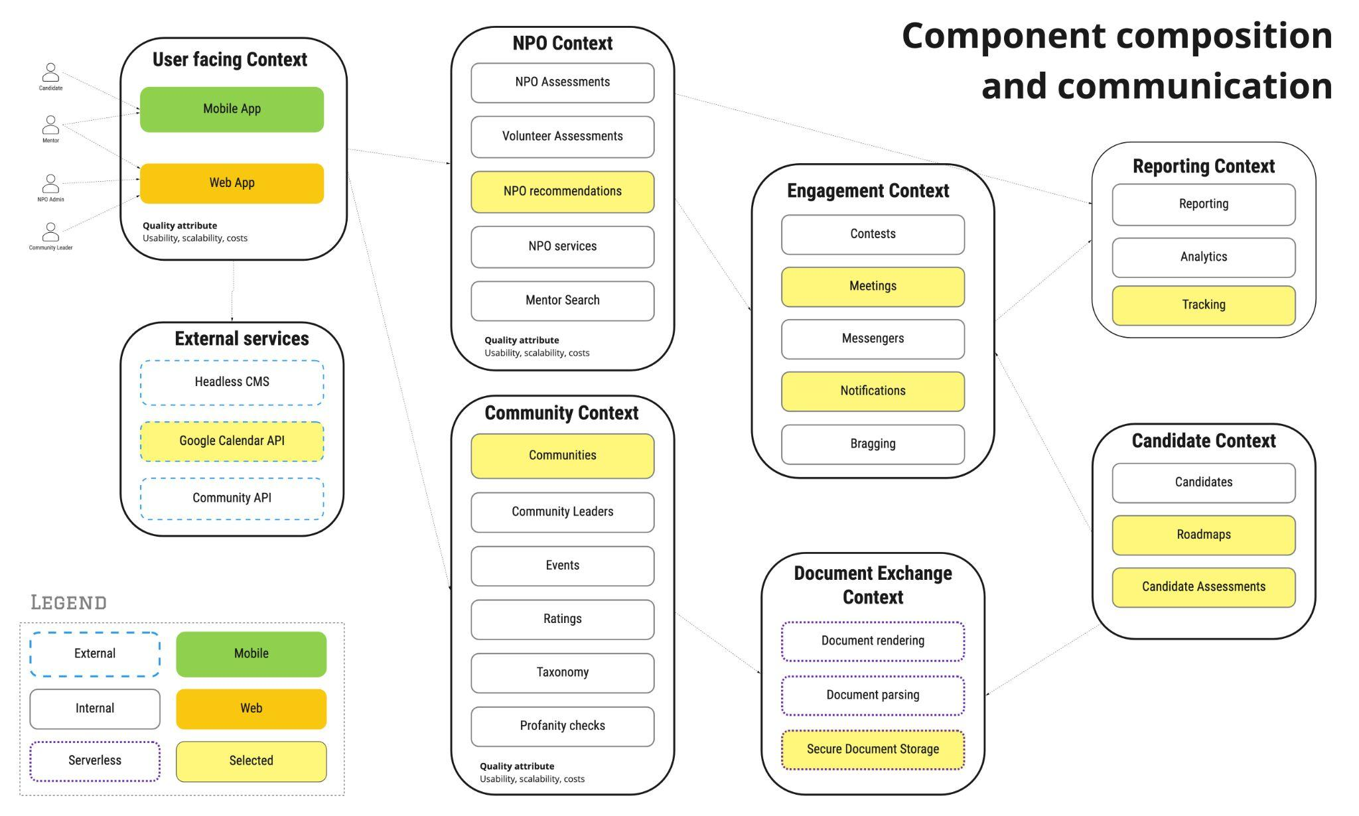
ADR-013
ADR-017
ADR-008
Notes:
This overview shows how data passes between different contexts of our Spotlight system.
We’ve highlighted the most important components, which are the working parts in our proof of concept.
For example let's discuss the engagement context …

Slide 14
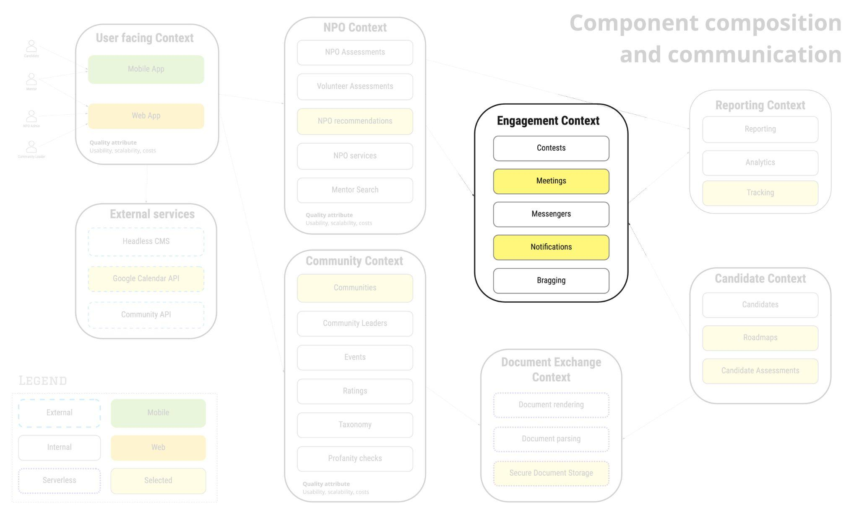
Notes:
It contains five modules. They are responsible for retaining users on our platform.
The contests module encapsulates all the gamification logic for challenges, capture the flags and hackathons.
The meetings module provides functionality to organize calls and meetings between all platform actors.
The messengers' module integrates with all popular social messengers, allowing in-app interaction.
The notifications module is responsible for the pushes and email notifications for the actors of the platform.
The bragging module enables sharing achievements, trophies and badges through social media.

Slide 15
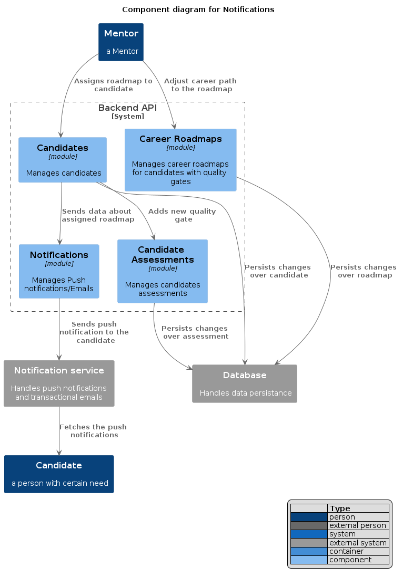
Notes:
This component diagram shows how the mentor interacts with the candidate, and vice versa, through the Spotlight modules

Slide 16
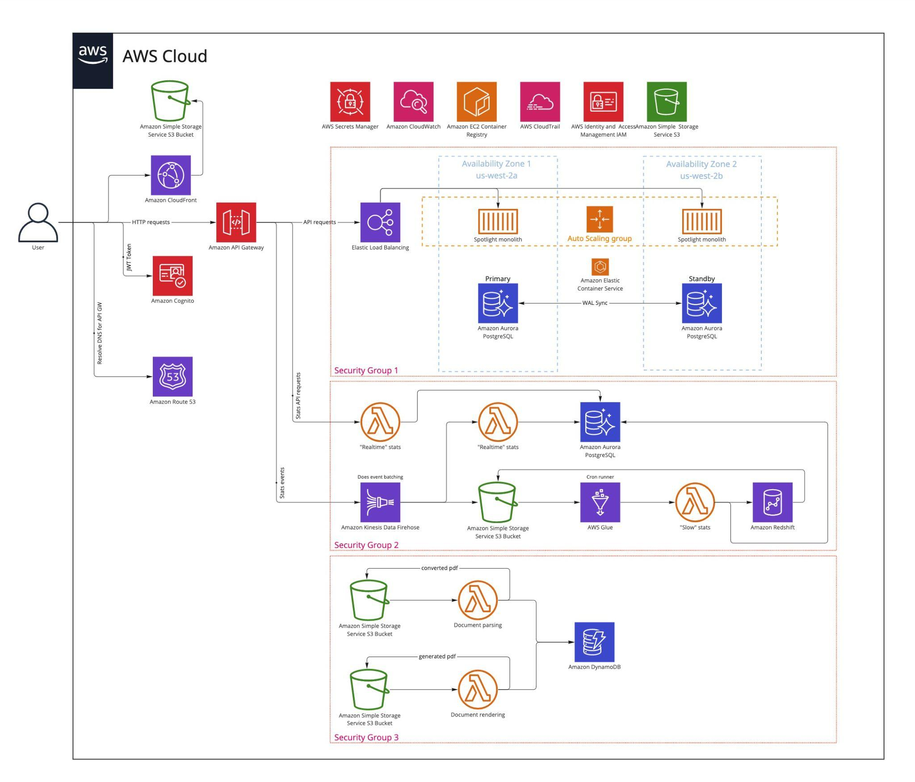
Deployment
ADR-009
ADR-005
ADR-010
ADR-004
ADR-006
Notes:
We want to scale Spotlight without spending too much time and resources, so we took the decision to deploy our system using AWS cloud.
Based on ADR-006 Zero-trust service communication security model, we split our deployment into three security groups. This isolates and minimizes the attack surface in case of an unlikely data breach.
The dedicated API gateway hides the two different API’s, the monolith scaling group and the Serverless data processing pipeline. Both of them scale well:
Monolith scales using auto-scaling groups in Elastic Container Service.
And Serverless uses AWS Lambda with Kinesis Data Firehose.
This deployment can handle any load spikes easily.

Slide 17
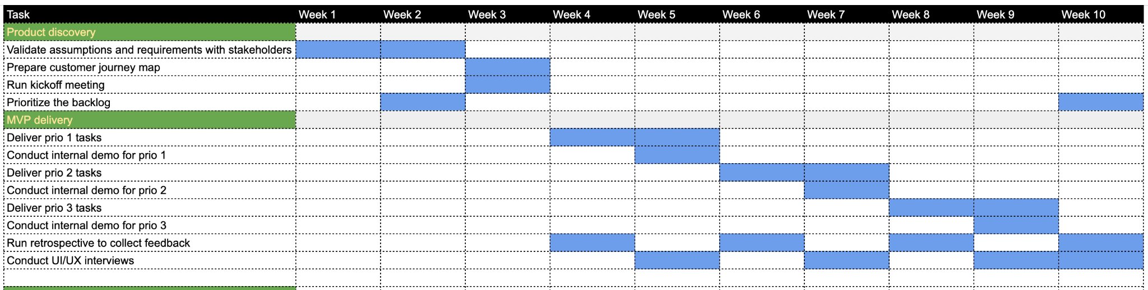
Roadmap
Notes:
This roadmap outlines our expected project timeline, once confirmation from real business owners and stakeholders is aligned.
To minimize waste, we’ve planned several Proof of Concept sprints.
Including from the start, progressive real user UI/UX testing to ensure the interface matches the project requirements.

Slide 18


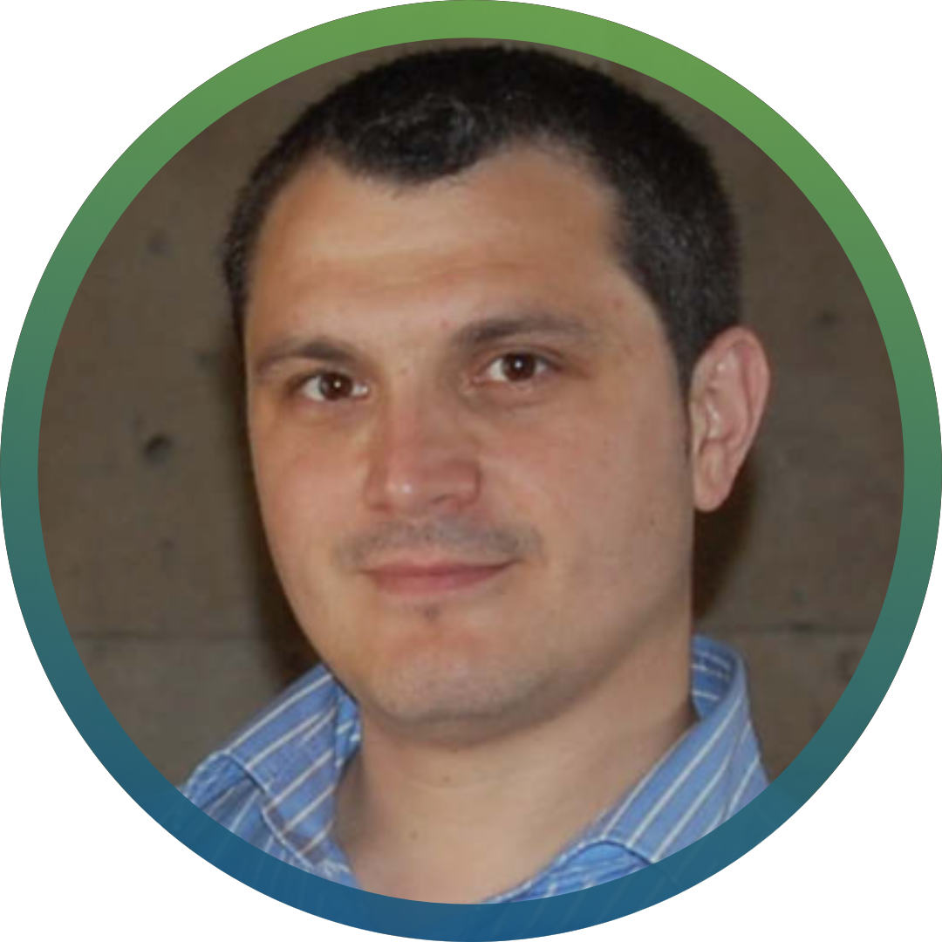
Team Arch🎱s
coordinated by
Jason Merry 🇬🇧
Andrey Orsoev 🇩🇪
Spotlight
Let's improve diversity in IT
Ivan Georgiev 🇬🇧
Notes:
Let's improve diversity in IT with team Arch8s! Thanks to O'Reilly and the organisers for this excellent opportunity!

